Slide 1
Exploring AWS Spot Instances within Kubernetes clusters
Under the guidance of Dan McPherson and Ravi Gudimetla
Aditya Kadam
Kevin Rodrigues
Nikhil Singh
Suryateja Gudiguntla

Slide 2
Recap
Load testing using Jmeter
Observed the impact on application due to scaling pods or nodes
Measured metrics to calculate the SLA
Notes:
So last sprint we deployed an application on the cluster and load tested it using Jmeter. We observed the impact on application and on the cluster due to scaling pods and nodes.we found out that scaling up and down was proving very costly for us for eg it took 20 mins for the cluster to stablize.
When we measured the metrics, we had no concrete idea on how we are going to use them to define our SLA. Also we were getting metrics related to application from the jmeter and there was no way to configure our controller to measure it.

Slide 3
Monitoring using Prometheus

Slide 4
Deployed Prometheus operator , node exporter and kube-state-metrics
Configured prometheus to scrape data from the nodes and pods as well as from the endpoints of the deployed application.
promhttp_metric_handler_requests_total
node_load
http_response_time
node_memory_utilization
Collected the data from the Go program with custom metrics for the controller algorithm to take further decisions
Notes:
Prometheus scrapes data from the /metric endpoints of the application
Prometheus now lets us measure application metrics as well as the node metrics from the cluster
Http requests to the application running in our cluster
Http req in forms of 200,500,503
Node load gives us the cpu load on the node
Req dur gives us the duration for that request(gives response times)
Node memory utilization (if lets say some pod has a database running on it and if it becomes full, the load has to be distributed)
We can calculate how much time the application was down by checking 500 errors.
This will help us to calculate the uptime of the application
All this data goes to the controller and the algorithm decides what important decisions like scaling up a node or scaling down is theres no load

Slide 5
Sample SLA Algorithm

Slide 6
Created a simple SLA algorithm which be will running on few conditions. Example -
If errors is high and cpu usage of node is high:
If no node is available in cluster with cpu usage is high:
If spot instance available below spot price:
Create a new spot instance and distribute load
Else:
Create a on demand node and distribute load
Else:
Distribute the load in the available nodes in cluster
Else
Continue
Notes:
We came up with a very simple SLA algorithm, which would invoke new nodes. I would like to share few examples -
If there is load running on the application, because of which the error rate and cpu usage spiked up, then we would look for nodes which are available in the cluster would have a low cpu usage and would distribute the load .If we are unable to find any such nodes then we would look for a spot instance which is less than the spot price and create on spot instance else we would create a new spot instance.
Suppose we are sending http requests through Jmeter on our application. After sometime if error rate increases, then we will have to check that it happened due to Scaling up or the load was high on the application. We would only invoke a new on-demand node if the error rate had increased due to high load and not for scaling up (And it would add to downtime).

Slide 7
Descheduler

Slide 8
Why we used descheduler
For kubernetes, balancing node workload takes priority over preventing duplicates running on the same node
Pods are not shifted to a new empty node, even if it has no load on it
Scheduling happens at pod creation only
Notes:
There may be situations when all pods are on the same node

Slide 9
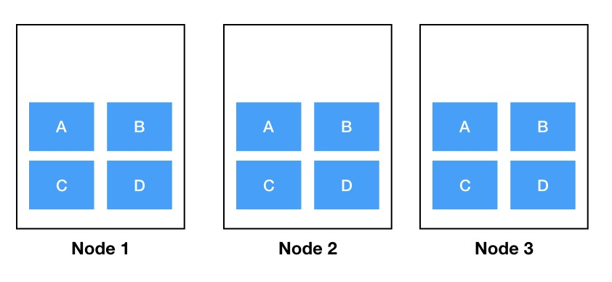
Initial state
Notes:
If a node goes down, the auto-scheduler shifts pods to existing available nodes

Slide 10
Node 3 deleted

Slide 11
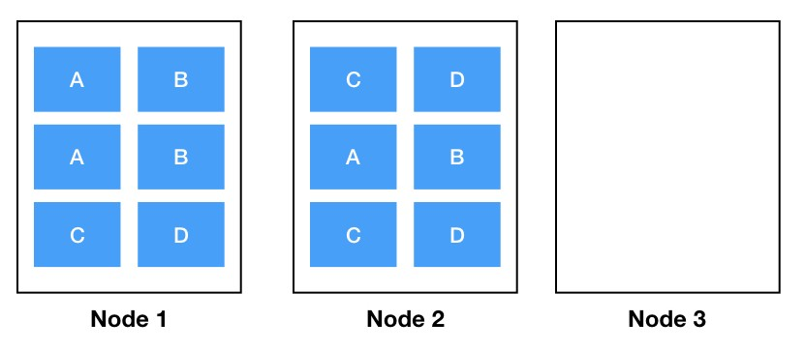
New node spun up depending on minsize (assumed to be 3 here)
Notes:
Kubernetes creates a new node if the minimum number of nodes don’t exist

Slide 12
Rolling deployment to release new version of ‘A’
Notes:
So, the scheduler is asked to place a new A v2 pod — the only place it can do so is Node 3. So far so good.
However, where should it put the other two? As mentioned above the scheduler tries to avoid having duplicates on the same node
but in that case node 3 is massively under-utilised compared to the other nodes.
So there is a high chance that all the new A v2 pods will be scheduled on Node 3, which would lead to this situation
And now we have a problem; all the A pods are on a single node. If Node 3 were to fail again we lose availability for service A

Slide 13
Descheduler
Descheduler, based on its policy, finds pods that can be moved and evicts them
Running descheduler as a job inside a pod has the advantage of being able to be run multiple times without needing user intervention
Multiple policies/strategies available:
Remove Duplicates
Removing pods violating NodeAffinity or PodAffinity
Low Node Utilization
Notes:
Descheduler does not deploy the evicted pods again on the desired nodes.
The default kube-scheduler does this based on the default strategy of deploying pods as stated earlier (balancing node workload takes priority)

Slide 14
Policy to decide when to use the Descheduler
The threshold thresholds can be configured for cpu, memory, and number of pods in terms of percentage
If a node's usage is below threshold for all, the node is considered underutilized
The threshold targetThresholds is used to compute those potential nodes from where pods could be evicted
The parameter numberOfNodes can be configured to activate the strategy only when number of under utilized nodes are above the configured value

Slide 15
New node from Go program

Slide 16
Spinning up a new node using GO program
Created a new node within the cluster without affecting other nodes
Automated the process of adding a new node to the cluster
Notes:
-We have learn how to spin up new nodes and attach it to existing cluster without a need of draining other nodes and spinning them up again.
-The algorithm Nikhil explained will be used to decide when a new node needs to be spinned up.
- Creating a new node through Kops is actually a manual process.

Slide 17
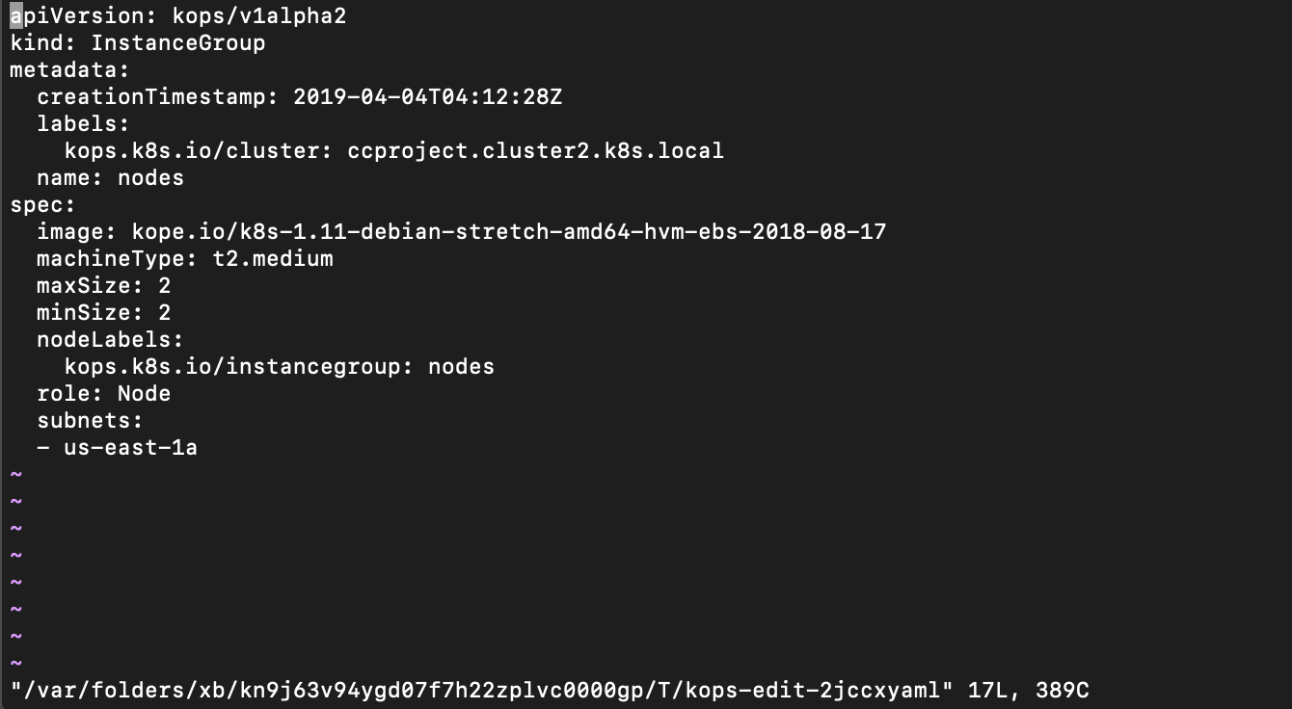
Kops edit instance group nodes
Notes:
- kops uses an s3 bucket and stores this yaml file there.
- Since our controller needs that we automate this process I created a shell script that will download this yaml file from the S3 bucket update this yaml file using a shell script and replaces the the file in the s3 bucket.

Slide 18
Created a new spot instance node using Kops and adding it to existing cluster

Slide 19
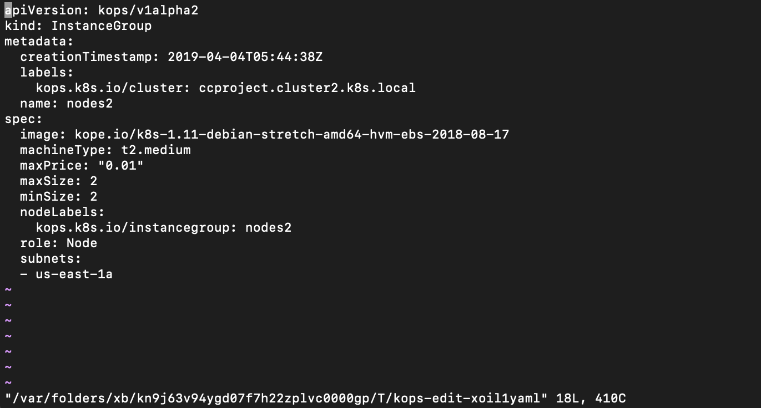
Created a new spot instance node using Kops and adding it to existing cluster
Notes:
-In kops to create a new node we need to create a new instance group and edit the yaml file for this group and add Maxprice attribute.

Slide 20
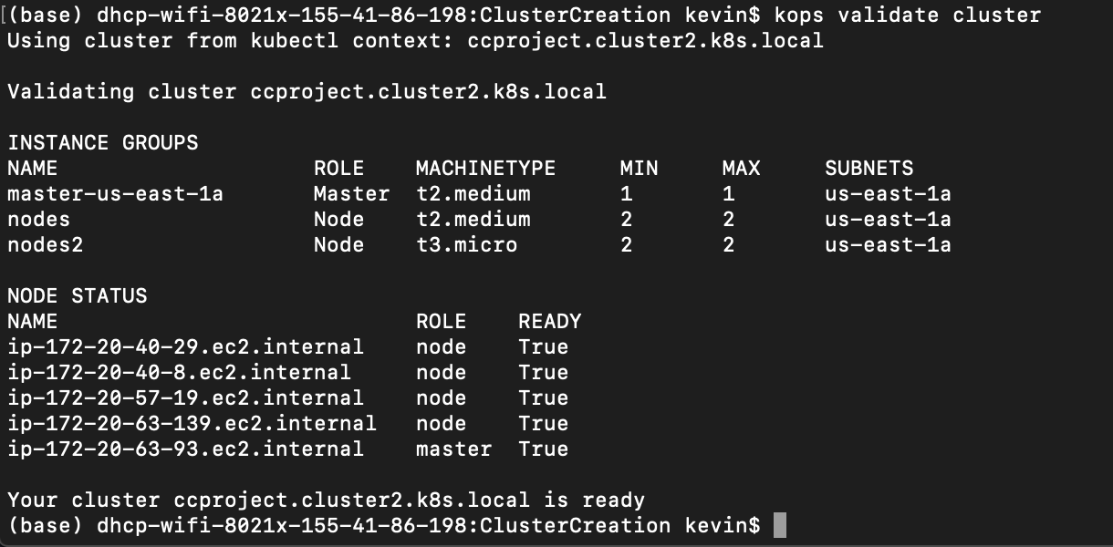
Existing cluster with new instance group for spot instance
Notes:
When we update the cluster we get two seperate ig.
Now when we need to spin up new node we either need to add it to on demand ig or spot instance ig

Slide 21
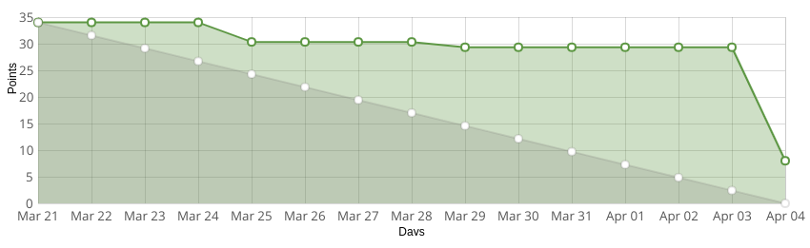
Taiga

Slide 22
Sprint 5

Slide 23
Goals
To develop the final algorithm and decide what action to be taken regarding new nodes
Testing limitations of the application under all types of workloads and defining the thresholds for the set of metrics to be used as SLA
Running the application for a specific period and calculating the cost saved
Notes:
Decide which type of node is to be spun up based on the decisions from the algorithm.
Defining the thresholds upto which our application is guaranteed to work flawlessly.

